Slide 1
Machine Learning for Drug Discovery
BIOINF / MedChem 595
Tuesday and Friday 11:30a - 1:00p
Room MedSci II 2813
Winter 2025
Matthew O’Meara & Terra Sztain

Slide 2
Outline for Today
Overview of the Syllabus
Learning Objectives, Expectations, Grading
Our backgrounds and research
Set-up computational environments
Brief overview of drug discovery

Slide 3
Background -- Matt O'Meara
Undergraduate Math at University of Chicago (graduated in 2007)
PhD from UNC Chapel Hill, 2013
Co-advised by Jack Snoeyink (CS) and Brian Kuhlman (Biochemistry)
Collaborated with RosettaCommons on the Rosetta Energy Function
Can we refine polar interactions by comparing geometries of simulated and real interactions?
Postdoc with Brian Shoichet at UCSF (2019)
Why do different receptors recognize similar drugs?
Chemoinformatic analysis of bioactive chemical space
How effective is large-scale docking?
Statistical analysis of hit-rate enrichment for virtual screening
Research Assistant Professor at UMich (2019-2023)
SARS-CoV-2 drug repurposing
Analysis of morphological profiling phenotypic screens
Assistant Professor at UMich (2023-Current)
How to combine large-scale bioactivity data with molecular simulations to learn chemical foundation models?

Slide 4
Background – Terra Sztain
Undergraduate
Pasadena City College 2011 - 2014 Biochemistry
UCLA 2014 - 2016 Biochemistry
epigenetics in drug resistant triple negative breast cancer
PhD
UCSD 2016 - 2021 Biochemistry
Advisors: Andy McCammon & Michael Burkart
Using protein dynamics to re-engineer natural product biosynthetic pathways
Elucidating dynamic mechanisms of SARS-CoV-2 viral proteins
Postdoc
Freie Universität Berlin 2021 - 2023 Mathematics and Computer Science
Machine learning driven simulations
Assistant Professor
UM 2023 - Present Medicinal Chemistry & Biophysics
Computer-aided molecular design

Slide 5
Prerequisites
Familiarity with linear algebra and basic programming (BIOINF-575 or equivalent), or approval by instructor
You all belong! You all have different backgrounds and learning objectives
ACTIVITY (10 minutes):
Pair up with someone you don't yet know in the class
Introduce yourself
Name, program, "non-fun-fact"
Tell each other what one of your main research interests
E.g. elevator pitch for your thesis project
What is one thing you are hoping to learn in the course
E.g. What is a transformer model?
What is one thing you are concerned about
What is a molecular orbital?

Slide 6
Grading
Participation 10%
Homework / Labs 30%
Paper Presentations 20%
Technical Reports
20% Structural Modeling
20% Bioactivity ML
Notes:
Class participation
Start at full points (10%)
reduce points for missing 3+ lecture/labs
reduce points for disruptions
gain lost points for particularly useful questions/engagement

Slide 7
Paper Presentations
Sign up for preferred topic / date
15 min presentation + 5 minutes questions at the end of each class
Scoring:
Criteria each is scored 1-5 and the score is summed to 20%
Clear statement of the problem
Clear summary of the results and methods
Clear description of the conclusions/limitations of the work
Answering questions about the work

Slide 8
Technical Reports
Criteria each is scored 1-5 and the score is summed to 20%
Clear statement of the problem
Methods detailed enough to be reproduced without any additional information
Clear description of the results/conclusions/limitations of the work
Informative figures conveying results
Format
2 pages not including references
11 pt font Arial (10 pt for figure legends)
Sections: Abstract, Intro, Methods, Results, Conclusion, References

Slide 9
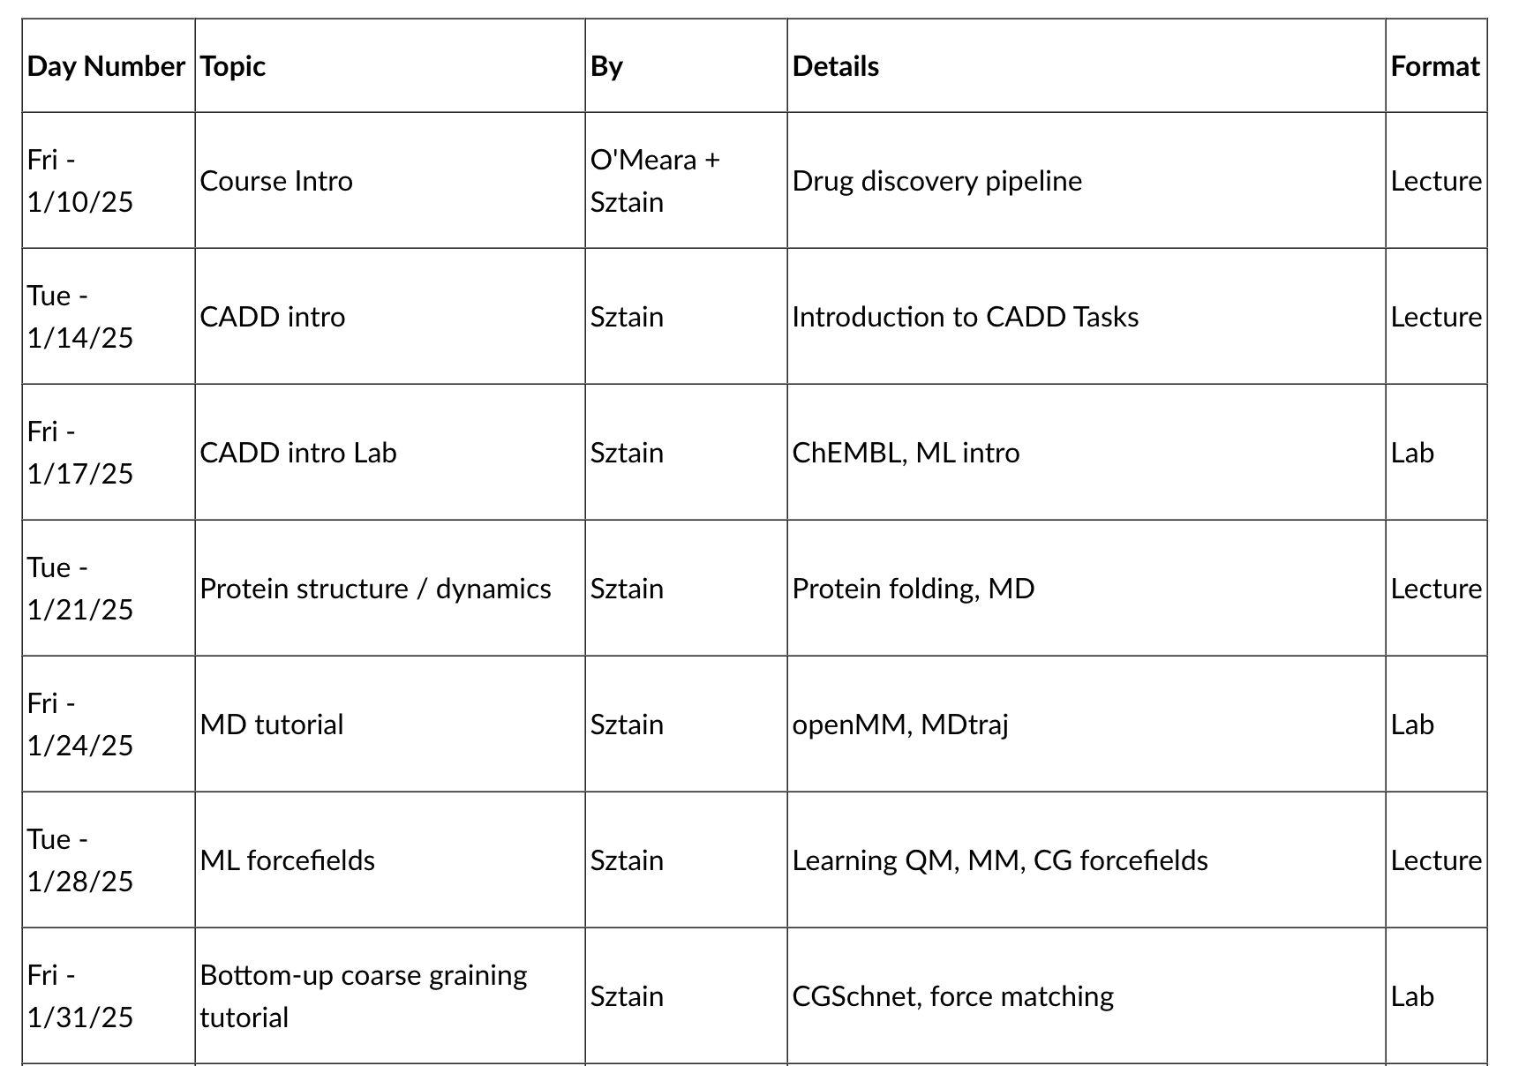
Schedule

Slide 10
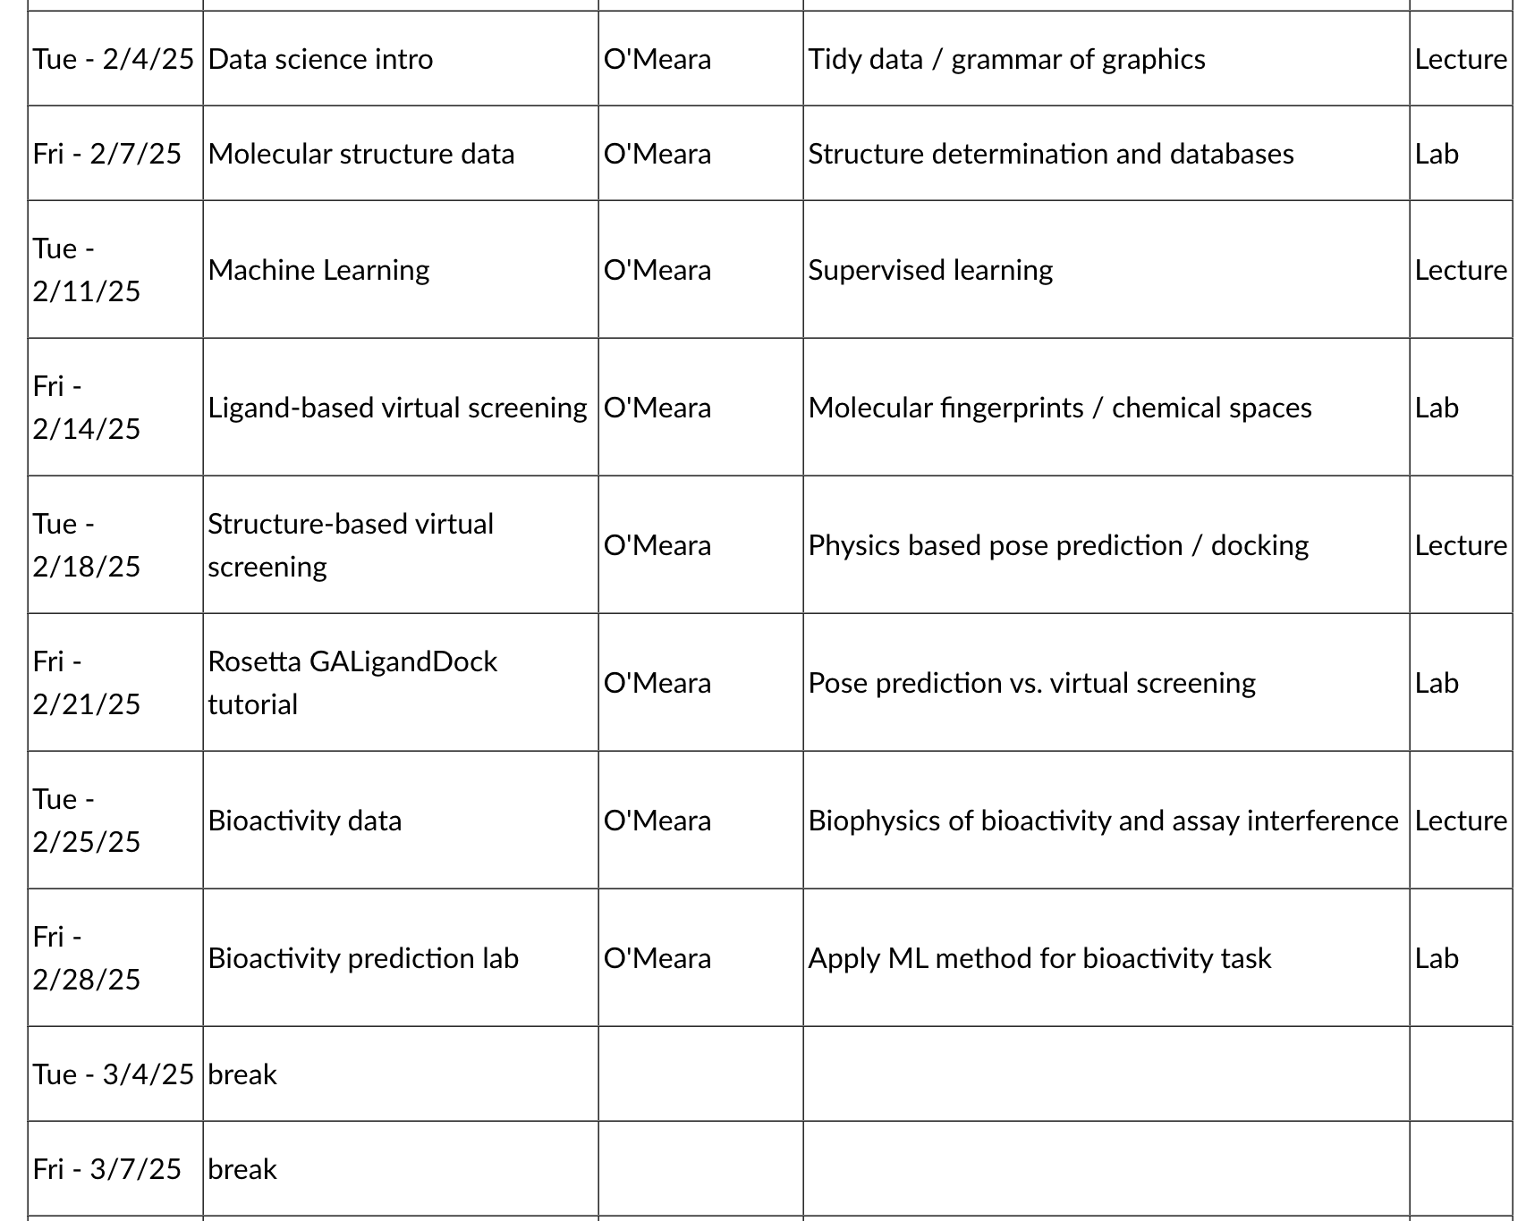
Schedule (cont.)

Slide 11
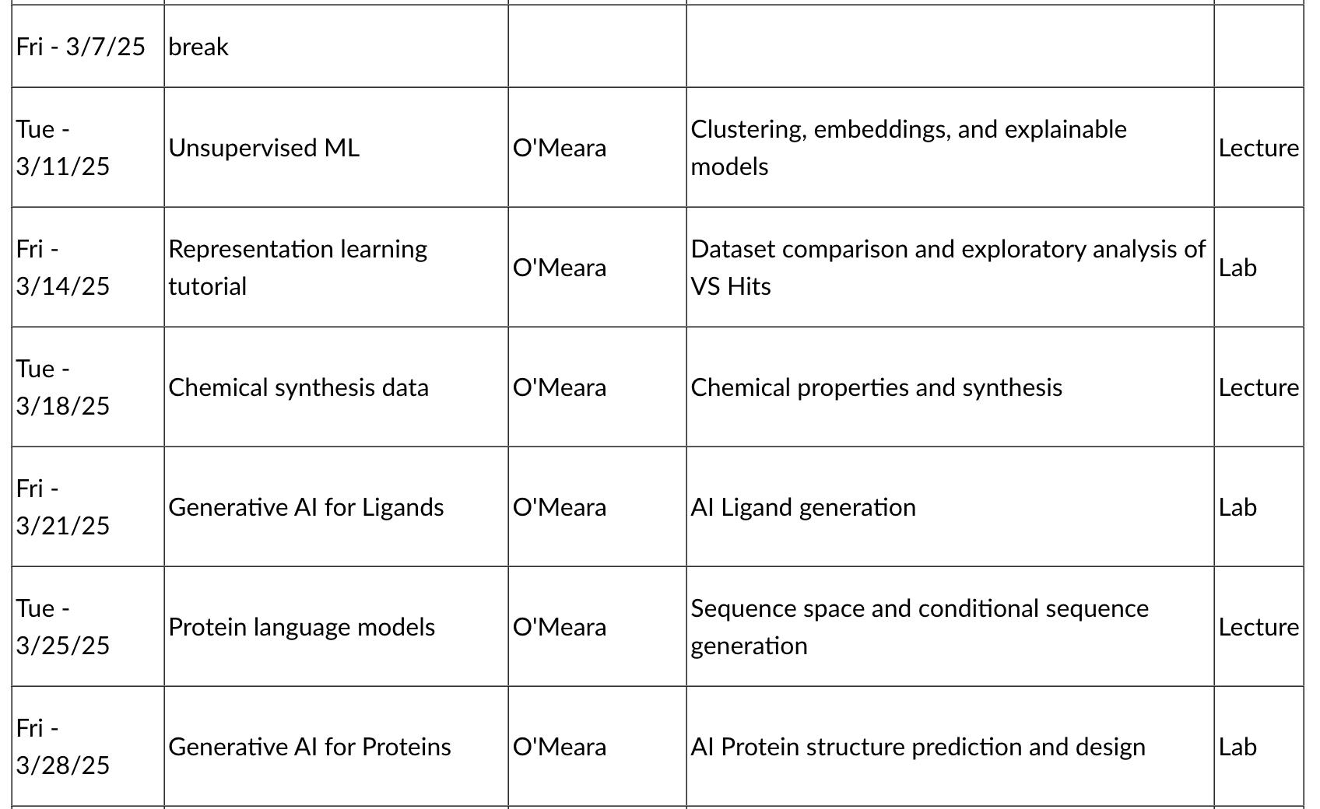
Schedule (cont.)

Slide 12
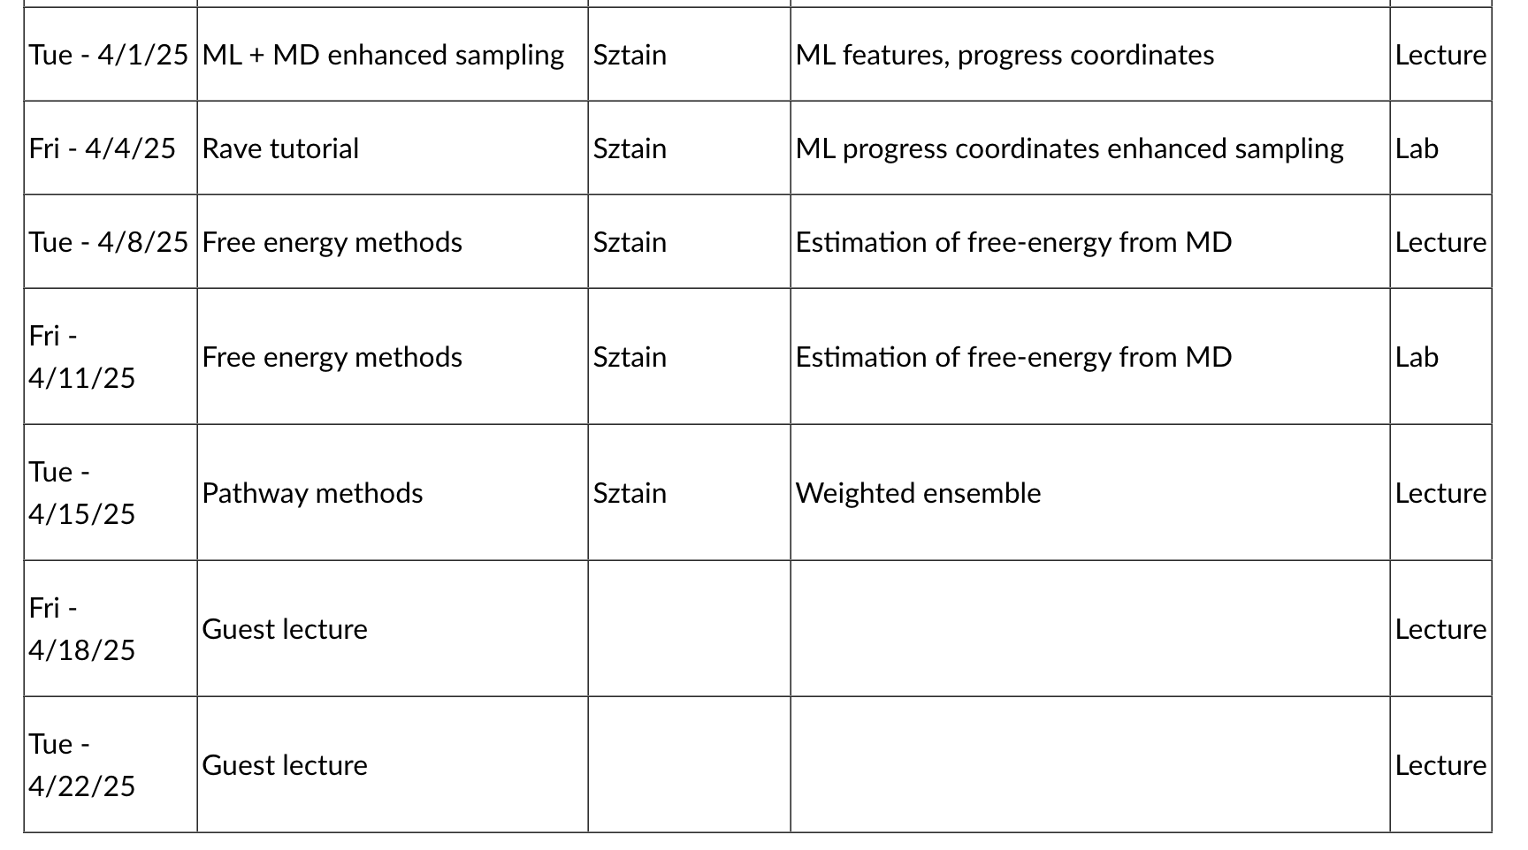
Schedule (cont.)

Slide 13
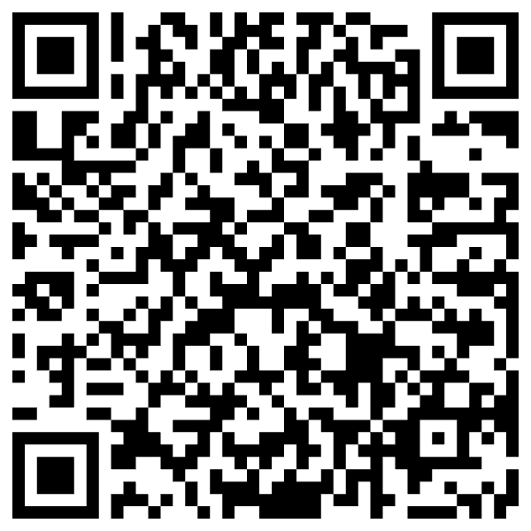
Computational Environments:
Great Lakes
Great lakes is a compute cluster managed by ARC-TS on campus
If you haven't already, sign up for an account =>
We'll go into details about how to use it, but check out the documentation/user's guide
Usage:
in browser: greatlakes.arc-ts.umich.edu
Command line: ssh greatlakes.arc-ts.umich.edu
store data for class: /nfs/turbo/dcmb-class/bioinf595/sec001/<uniqname>
submit jobs using this account: bioinf595w25_class
Each student has $60 of credits
Tips:
Don't run jobs on the login node, use interactive or batch jobs
Use Tmux to be able to disconnect/reconnect

Slide 14
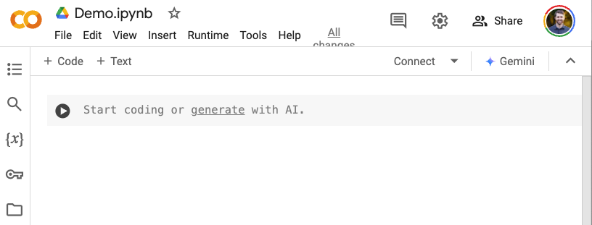
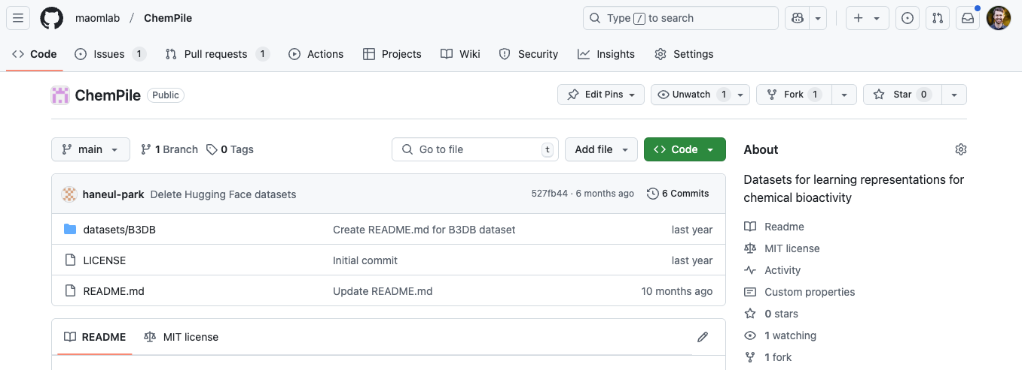
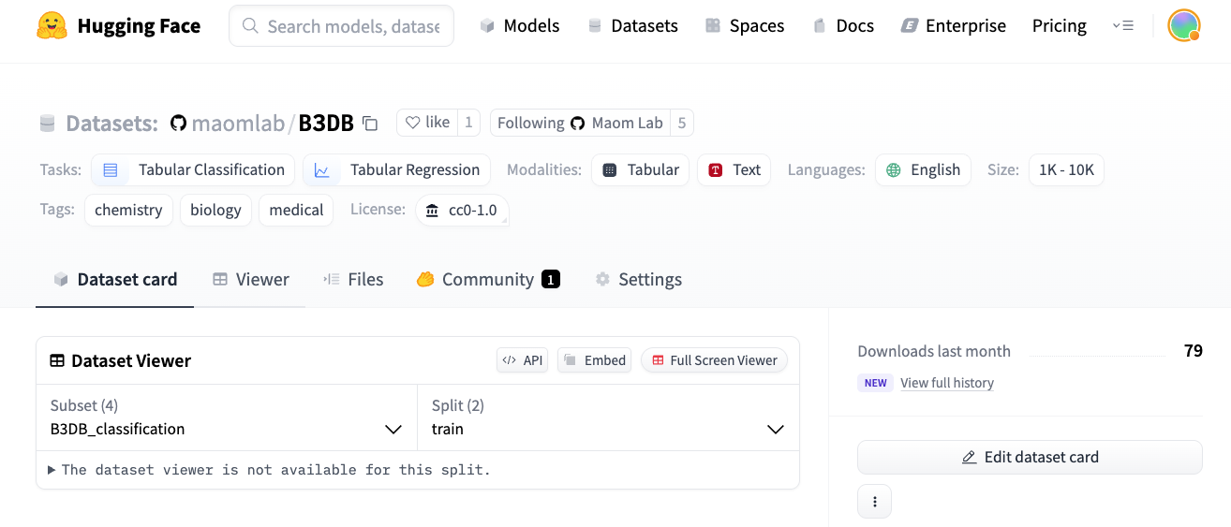
Computational Environments:
Web resources
Google Colab
Platform for computational notebooks
Go to: https://colab.research.google.com/
GitHub
Platform for sharing code using git-repositories
Go to: https://github.com/
HuggingFace
Platform for sharing datasets, models, demos
Go to: https://huggingface.co/

Slide 15

Submit your Account names!

Slide 16
Editors
Good choices:
GUI: VS Code, R-studio
Terminal: emacs, VIM
AI focused: Cursor, Windsurf
Considerations:
Learning an editor is an investment that pays off
I use emacs when I login to great lakes and Rstudio when I'm working with R code locally
Most folks in my lab use VS Code and some emacs/VIM
I'm curious to hear anyone's experience with Cursor/Windsurf
Windows/MacOS/Linux are all fine

